Slide 1
PIANO TILES
YIFEI FENG

Slide 2
HOW To PlaY
The game will create 5 rows of tiles, player should tap black tiles and avoid white tiles, it will show how many black tiles player taped after you taped a white tile.
Using → ↑ ↓ ← to tap the tiles.
Player can choose difficulty(easy, normal and hard) in home.
Player can come back to home or exit the game in the menu.

Slide 3
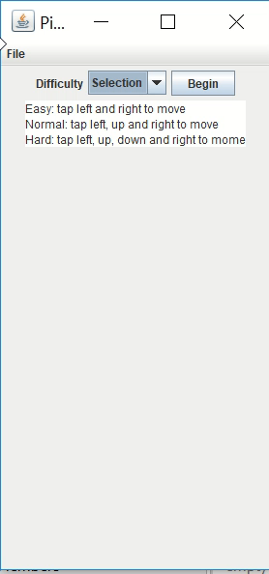
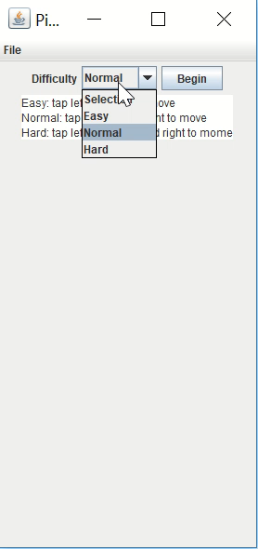
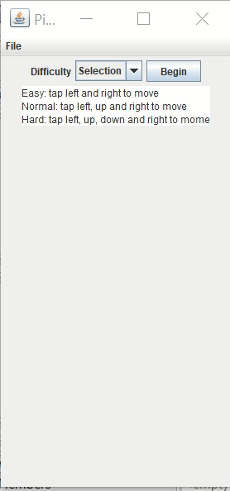
Sample of PLay

Slide 4
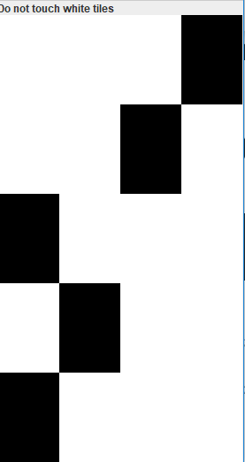


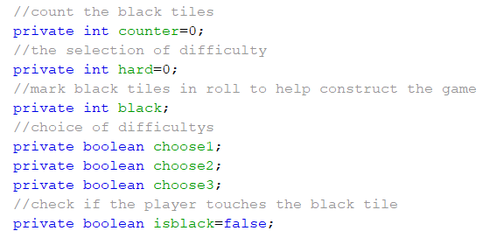
KEY VARIABLES

Slide 5
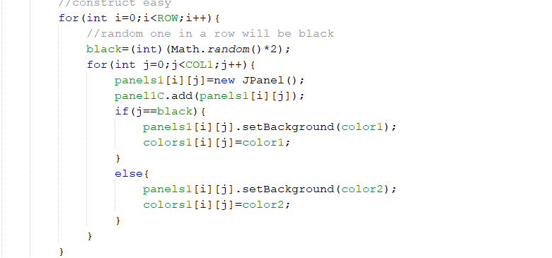
Create piano

Slide 6
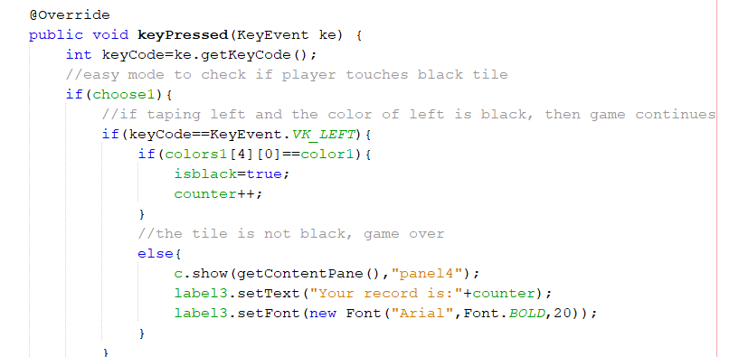
Key listener

Slide 7
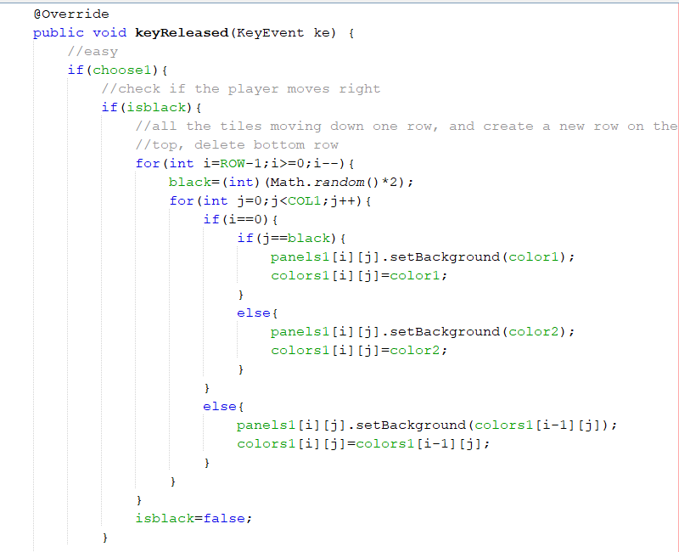

Slide 8
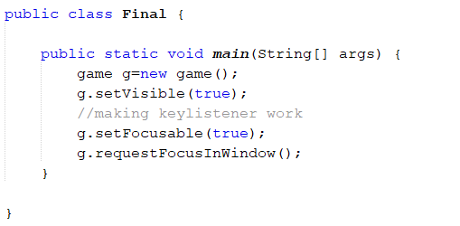
Now it works☺

Slide 9

Thank you

